Slide 1

Predictive Lead Conversion Using Metadata
Submitted by:
Memon Mohammad Ayan Anwar
Paresh Gorakh Patil
Organisation: Tara Metal Industries, Ahmedabad
Course: Intel® AI for Manufacturing Certification
Group ID: G00060

Slide 2

Project Overview
Project Title:
Predictive Lead Conversion Using Metadata
Description:
This project aims to improve the low lead conversion rates (~1.5%) faced by many businesses. By using AI and machine learning, we analyze user metadata such as behavior, engagement, and demographics to predict which leads are more likely to convert, enabling more effective marketing and sales targeting.
Timeline:
Data understanding & cleaning
Model development
Evaluation & tuning
Streamlit deployment and documentation

Slide 3


Project Overview (Continue)
Benefits:
Risks & Challenges:
Improves lead conversion rates.
Imbalanced dataset affecting model learning.
Enhances marketing efficiency.
Incomplete metadata or missing values.
Saves time by filtering low-conversion leads.
Streamlit package compatibility issues (resolved).

Slide 4

Objectives
Primary Objective:
Build a machine learning model that predicts whether a lead will convert using behavioral metadata.
Secondary Objectives:
Clean and preprocess a real-world dataset.
Deploy the model using a user-friendly web app.
Evaluate and improve prediction accuracy.
Measurable Goals:
Model accuracy > 80%
Functional Streamlit app deployed publicly
Clear lead scoring output (YES/NO)

Slide 5
Methodology
Approach:
Agile-style, iterative development
Phases:
1
2
3
4
5
1. Data Exploration & Cleaning
2. Preprocessing (encoding, handling missing values)
3. Model Training (Logistic Regression)
4. Model Evaluation (Accuracy, F1-score, Confusion Matrix)
5. Deployment via Streamlit
Deliverables:
Trained ML model (.pkl)
Streamlit app (app.py)
Complete Jupyter
Notebook Public app URL

Slide 6
Technologies Used
Programming Language:
Tools:
Python 3.10
Jupyter Notebook – Development
Frameworks & Libraries:
GitHub – Version control and project hosting
Pandas, NumPy – Data processing
Cloud Services:
scikit-learn – ML model and evaluation
Streamlit Cloud for web hosting
Streamlit – App development & UI
Pickle – Saving the trained model

Slide 7
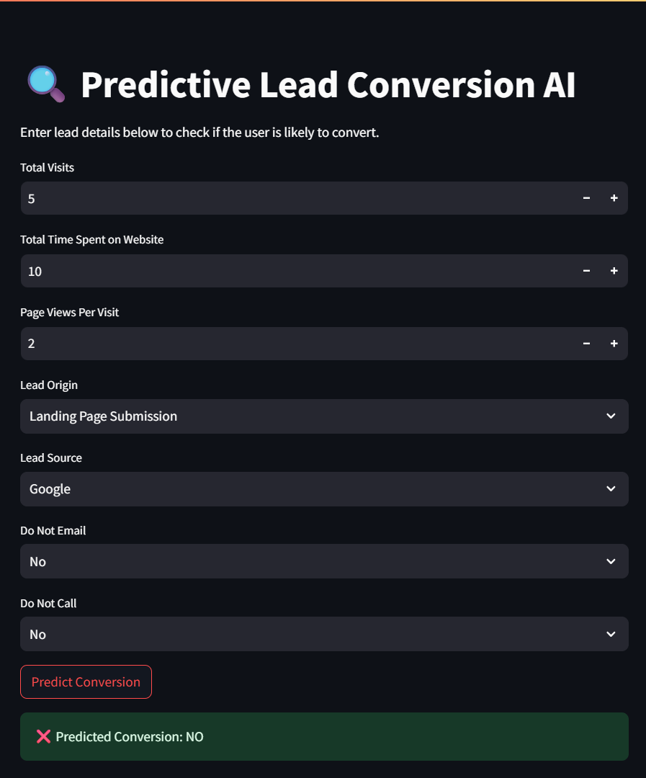
Results
Key Metrics:
Accuracy: ~85%
Balanced Confusion Matrix
Real-time prediction output with high confidence
Demonstration:
Functional app deployed:
🔗 https://predictive-lead-conversion.streamlit.app
Impact:
Predicts lead conversion effectively
Gives marketers a simple YES/NO tool to prioritize leads

Slide 8

Conclusion
Recap:
We successfully built and deployed a lead prediction system using real metadata. The AI model is trained, evaluated, and accessible as a web app.
Key Takeaways:
Metadata can provide strong predictive signals.
Streamlit is powerful for fast AI deployments.
Real-world project improved model understanding.

Slide 9
Conclusion (Continue)
Future Plans:
Test with larger datasets or real business data.
Try advanced models like XGBoost or Neural Nets.
Add lead score probability (0–1) instead of binary output.
Successes & Challenges:
Smooth deployment with working model.
Achieved target accuracy.
Initial data imbalance required adjustments.
Deployment required multiple package fixes.

Slide 10

Deployment Links
GitHub Link: https://github.com/AyanMemon296/Predictive-Lead-Conversion
Deployment Link: https://predictive-lead-conversion.streamlit.app/
Report Link: https://github.com/AyanMemon296/Intel-AI-Certification/tree/main/Project/Predictive-Lead-Conversion/Predictive_Lead_Conversion_Report.pdf

